Slide 1

Goal of Reinforcement Learning
Notes:
1

Slide 2
Objectives
Understand reinforcement learning and compare with other types
Describe how rewards relate to the goal of an agent
Identify episodic tasks
Goal of Reinforcement Learning
2
Notes:
2

Slide 3
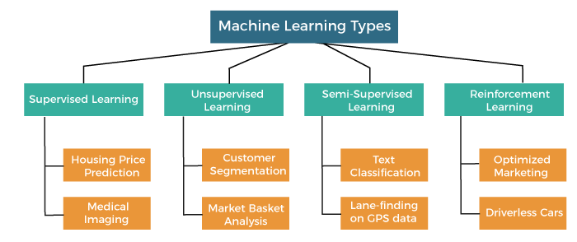
Reinforcement Learning
Goal of Reinforcement Learning
3
Notes:
3

Slide 4
Reinforcement Learning
Reinforcement learning works on a feedback-based process, taking action, learning from experiences, and improving its performance.
Agent gets rewarded for each good action and get punished for each bad action;
The goal of reinforcement learning agent is to maximize the rewards.
Goal of Reinforcement Learning
4
Notes:
4

Slide 5
Reinforcement Learning
There is no labelled data like supervised learning, and agents learn from their experiences only.
The reinforcement learning process is similar to a human being; for example, a child learns various things by experiences in his day-to-day life.
Goal of Reinforcement Learning
5
Notes:
5

Slide 6
Reinforcement Learning
Reinforcement learning is categorized mainly into two types of methods:
Positive Reinforcement Learning: increasing the tendency that the required behavior would occur again by adding something.
Negative Reinforcement Learning: increases the tendency that the specific behavior would occur again by avoiding the negative condition.
Goal of Reinforcement Learning
6
Notes:
6

Slide 7
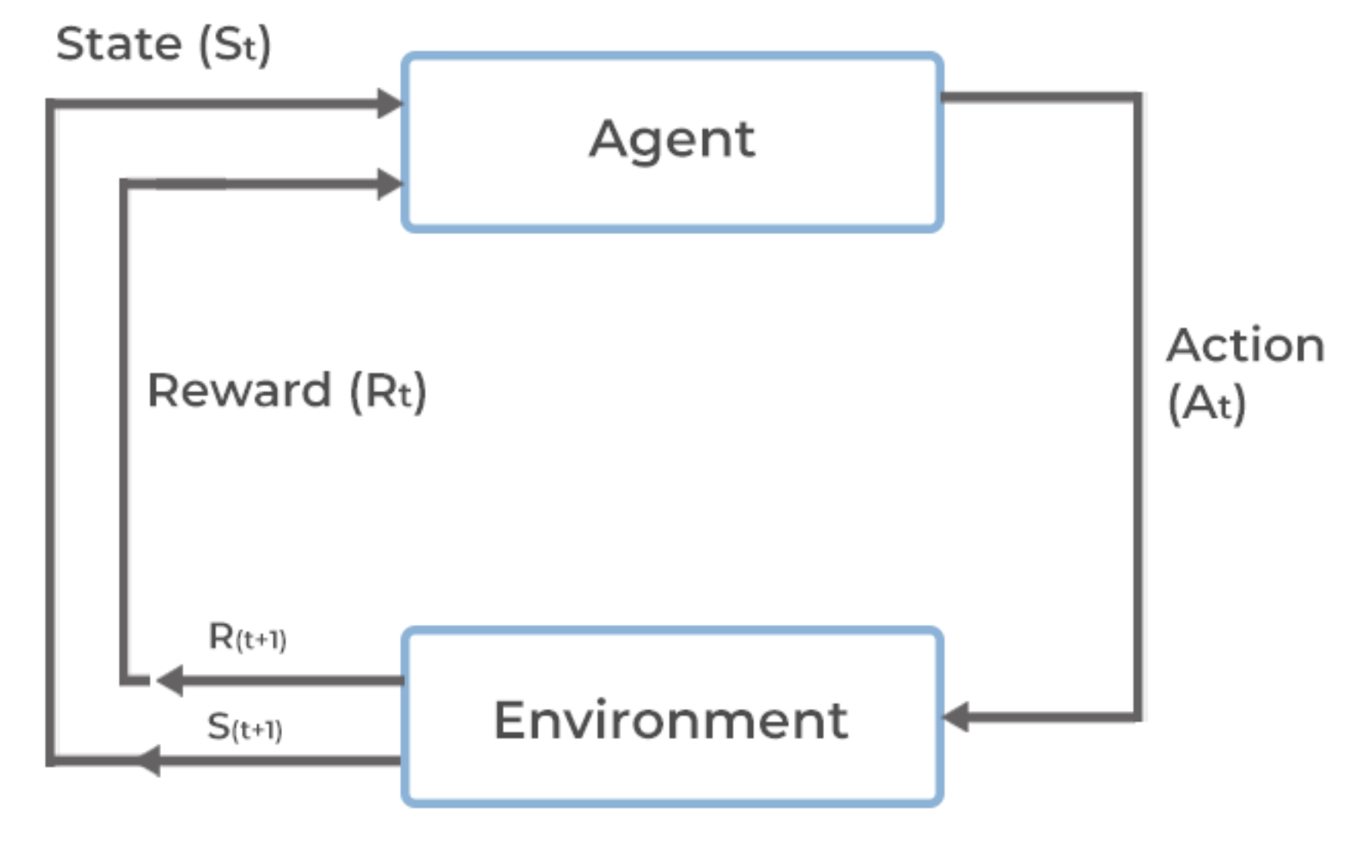
Reinforcement Learning
Key components of reinforcement learning
Goal of Reinforcement Learning
7
Notes:
7

Slide 8
Reinforcement Learning
Key components of reinforcement learning include:
Agent: The learner or decision-maker that interacts with the environment.
Environment: The external system with which the agent interacts.
State: A representation of the current situation or configuration of the environment, which provides all relevant information necessary for decision-making.
Goal of Reinforcement Learning
8
Notes:
8

Slide 9
Reinforcement Learning
Key components of reinforcement learning include:
Action: The set of possible moves or decisions that the agent can take at any given state.
Reward: A scalar feedback signal received by the agent after taking an action in a particular state.
Policy: A strategy or mapping from states to actions that the agent follows to select actions.
Goal of Reinforcement Learning
9
Notes:
9

Slide 10
Reinforcement Learning
 | Supervised Learning | Reinforcement Learning
Objective | Supervised learning aims to learn a mapping from input data to output labels based on labeled training examples. | Reinforcement learning focuses on learning a policy to maximize cumulative rewards by interacting with an environment.
Training Data | Supervised learning algorithms require a dataset consisting of input-output pairs, where the correct output (label) is provided for each input. | RL algorithms learn from feedback in the form of rewards received after taking actions in the environment. They do not require labeled datasets but learn from trial and error.
Feedback Signal | The training process relies on a feedback signal in the form of labeled data. The algorithm adjusts its parameters to minimize the discrepancy between predicted and actual outputs. | The feedback signal in RL comes in the form of rewards, which indicate the desirability of actions taken by the agent.
Goal of Reinforcement Learning
10
Notes:
10

Slide 11
Reinforcement Learning
 | Supervised Learning | Reinforcement Learning
Use Case | Supervised learning is suitable for tasks such as classification, regression, and object detection, where there is a clear distinction between input features and output labels. | RL is suitable for sequential decision-making tasks, where actions influence future states and outcomes. It is commonly used in robotics, game playing, autonomous driving, and resource management.
Examples | Image classification, spam detection, sentiment analysis. | Playing chess or Go, robotic control, autonomous driving.
Goal of Reinforcement Learning
11
Notes:
11

Slide 12
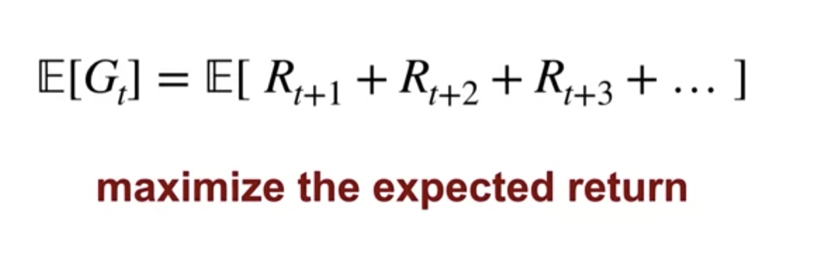
Reinforcement Learning
The goal of reinforcement learning: maximizing total future reward
Goal of Reinforcement Learning
12
Notes:
12

Slide 13
Episodic Tasks
Episodic tasks are a type of task in reinforcement learning (RL) where the agent interacts with the environment in discrete episodes.
Each episode consists of a sequence of steps or time steps, starting from an initial state, progressing through a series of state-action transitions, and ending in a terminal state.
Goal of Reinforcement Learning
13
Notes:
13

Slide 14
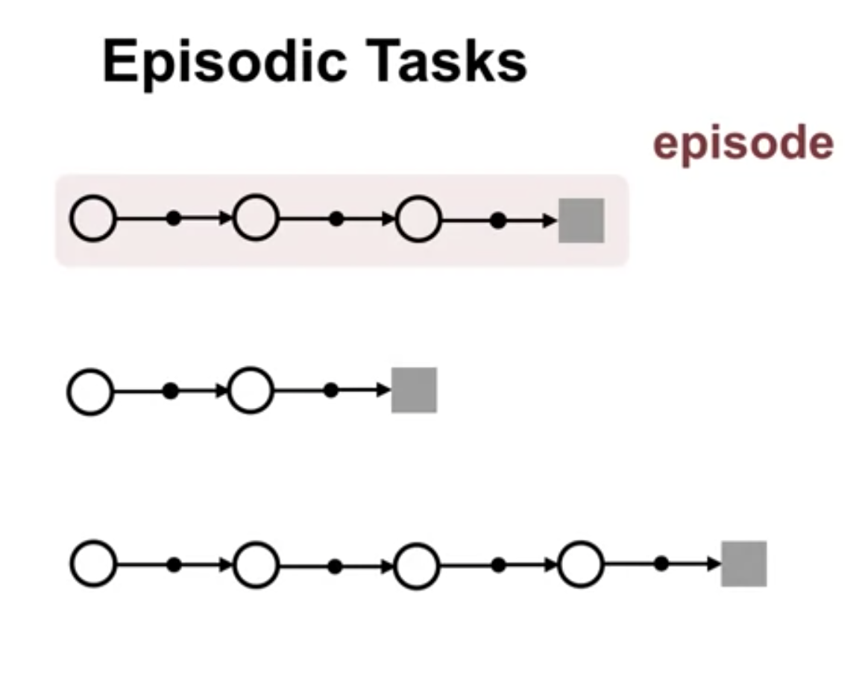
Episodic Tasks
Goal of Reinforcement Learning
14
Notes:
14

Slide 15
Episodic Tasks
Key characteristics of episodic tasks include:
Episode Termination: Each episode terminates after a finite number of time steps or when a specific condition is met. Once an episode ends, the environment resets to its initial state, and a new episode begins.
Finite Horizon: Episodic tasks have a finite horizon, meaning there is a fixed number of time steps within each episode before termination. The length of an episode may vary depending on the task and environment.
Goal of Reinforcement Learning
15
Notes:
15

Slide 16
Episodic Tasks
Key characteristics of episodic tasks include:
Goal-Oriented: In many cases, episodic tasks involve achieving a specific goal or objective within the episode. The agent's goal is to learn a policy that maximizes cumulative rewards or achieves the desired outcome over the course of the episode.
Goal of Reinforcement Learning
16
Notes:
16

Slide 17
Episodic Tasks
Examples of episodic tasks include playing a single game of chess, completing a maze, navigating a robot to a target location, or solving a puzzle within a fixed number of moves. In these scenarios, the agent's objective is typically to achieve a certain state or goal state within the episode.
Goal of Reinforcement Learning
17
Notes:
17

Slide 18
Summary
Understand reinforcement learning and compare with other types
Describe how rewards relate to the goal of an agent
Identify episodic tasks
Goal of Reinforcement Learning
18

Slide 19
Q & A
Goal of Reinforcement Learning
19

